Slide 1
Western Australian entrepreneurs

Slide 2
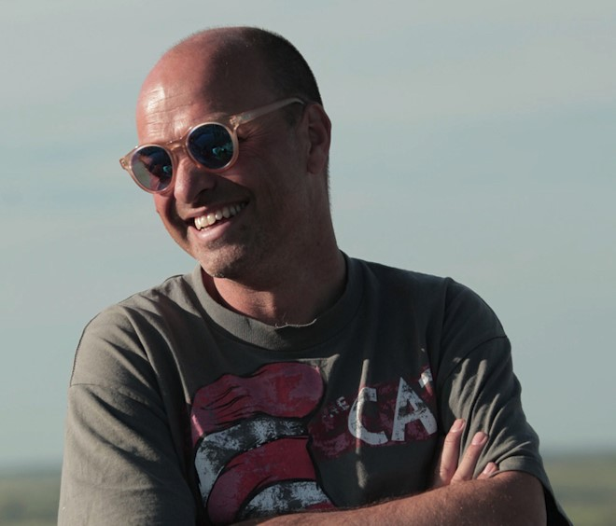
Gary Cass – Cass Materials
Gary received a Bachelor of Science from the University of Western Australia and has over 20 years’ experience in all levels of education across a wide range of the biological sciences.
Gary co-founded Nanollose Ltd, a fibre technology company that created Nullarbor FibreTM – the world’s first tree-free rayon.
He has published in the science and art world, being a key creative collaborator with numerous international art–science projects, including:
Fermented Fashion, the first dresses in the world made from the bacterial fermentation of wine, which gained media coverage
the app iDNAtity Audio – making music from your genes.
Cass’s collaborative projects have been exhibited around the world, including at: a fringe event at the Venice Biennale and Documenta Germany; Trinity College Science Gallery, Ireland; Signature Art Prize, Singapore; and ArtStays, Slovenia.
For more information, access:
https://cassmaterials.com/
https://youtu.be/ab6RV3E6XkI
Image 1

Slide 3
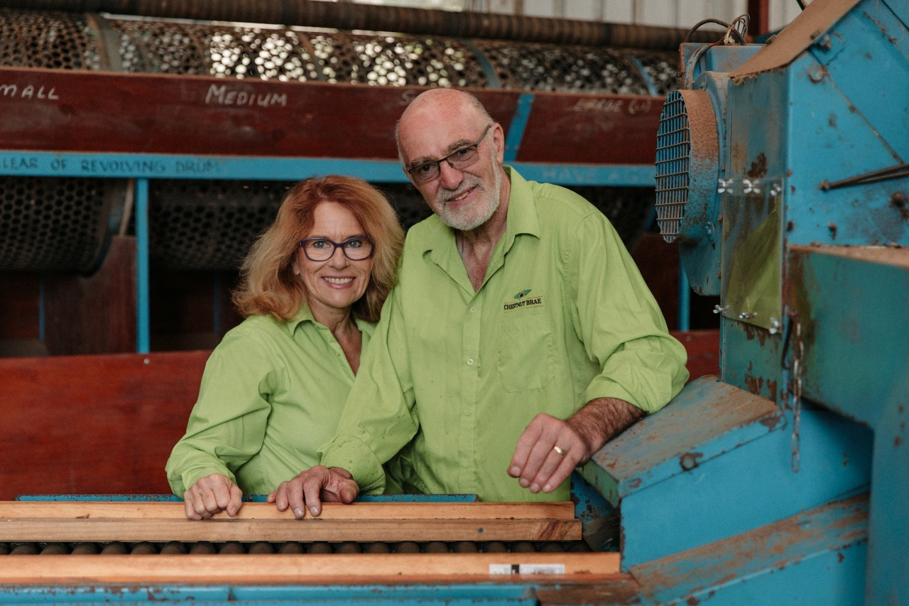
John and Linda Stanley – Chestnut Brae
John and Linda Stanley bought Chestnut Brae in 2013 as a sweet chestnut farm:
“When we purchased the farm there was lot of maintenance required to bring it back to being productive farm.
Our aim was to move the farm from being a commodity farm to being a value-added producer.”
Setbacks:
financial restrictions – a challenge to all developing businesses
the COVID-19 pandemic
the weather, especially during flowering time (if it is too hot) and harvesting time (if it is too wet).
Image 2

Slide 4
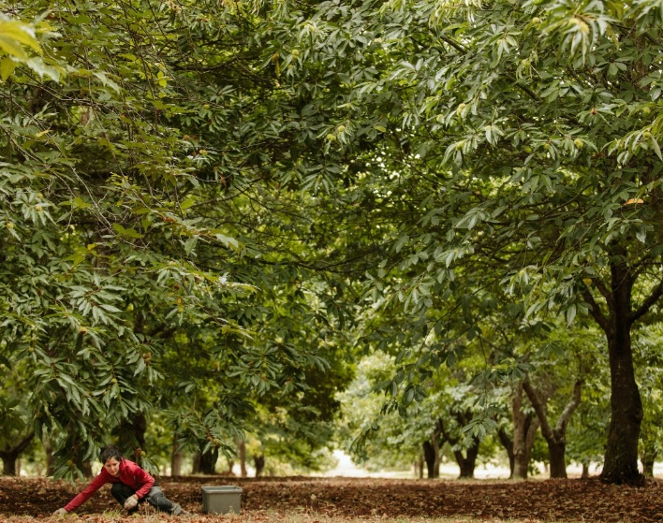
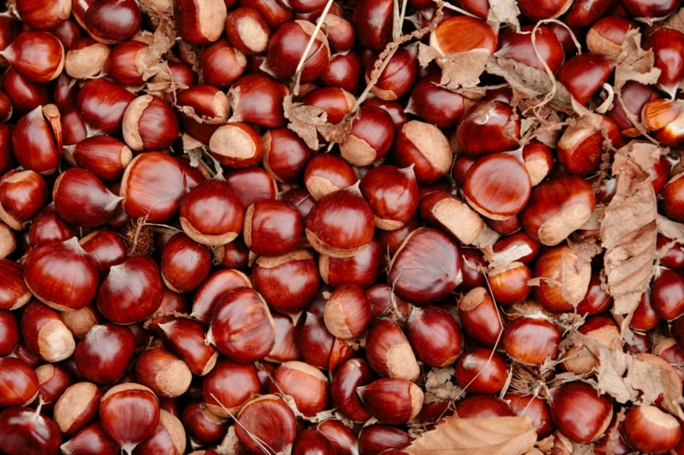
The products:
Innovations:
Australia’s only chestnut flour mill
Free-range Wessex Saddleback pigs are raised on sweet chestnuts
WA’s only commercial peeling machine for chestnuts
Sweet chestnuts
Added-value sweet chestnut products:
chestnut-fed pork
chestnut
chestnut ale
Chosen because:
“the product is not a widely known one, so we could put a distinctive brand and marketing strategy together
with a unique product we could differentiate ourselves in the marketplace.”
Image 3
Image 4

Slide 5
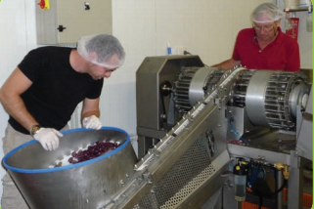
Gerard and Leanne Bunter and Eric and Jill Dixon – Eagle Vale Olives
A local family-owned business established in 1995.
Products include olive oil, pickled olives and marinades.
The owners are responsible for growing, harvesting, marketing, product development, employment of staff and maintaining the quality of the products.
The business success is due to diversification. Market research and response to demand has seen the business develop new products.
For more information, access: https://eaglevaleolives.com.au/
Image 5
WA’s first pitting and slicing machine. Eagle Vale Olives responded to market research and bought the technology required to supply pitted and sliced olives.

Slide 6
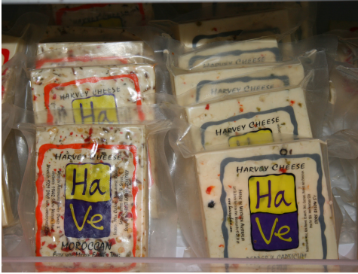
Robert and Penny St Duke – Harvey Cheese
Established in 2001.
He learnt cheesemaking after buying the company. Enthusiasm and determination were essential due to a lack of experience in the industry.
Cheeses have unique names (like OMG! cheese, Ash Blonde and Ring Stinger) as a marketing strategy to set them apart from other cheese brands and to retain customers.
Understanding demographics is important for success. The logo is designed for people to recognise without their glasses on!
Image 6

Slide 7
Acknowledgements
Slide 2: Text and Image 1 courtesy of Gary Cass
Slides 3 and 4: Text and Images 2, 3 and 4 courtesy of John and Linda Stanley
Slide 5 : Text and Image 5: Department of Agriculture and Food (2011) ‘Eagle Vale Olives: reach for the sky’ [PDF], Noteworthy 36: Small Landholder Series, Western Australian Agriculture Authority <http://urbanlocavore.com.au/wp-content/uploads/2012/10/nw36_eaglevaleolives_lr-pdf.pdf>
Slide 6: Text and Image 6: Department of Agriculture and Food (2014) ‘Small producer case study: Harvey Cheese’ [PDF], Noteworthy 43: Small Landholder Series, Western Australian Agriculture Authority <https://www.agric.wa.gov.au/sites/gateway/files/Noteworthy%2043%20-%20Small%20producer%20case%20study%20-%20Harvey%20Cheese.pdf>

